Slide 1

UE22EC351B
TRANSMISSION LINES, WAVEGUIDES, AND ANTENNAS
Prof. Prajeesha
Department of Electronics and Communication Engineering

Slide 2
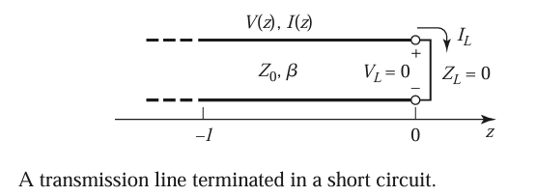
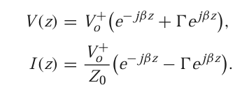
SHORT CIRCUITED LINE
Consider first the transmission line circuit where a line is terminated in a short circuit, ZL = 0.
The reflection coefficient for a short circuit load is Г =−1 , then the standing wave ratio is infinite.
From the below equation

Slide 3
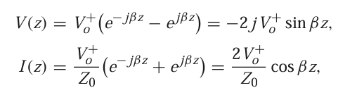

SHORT CIRCUITED LINE
which shows that V = 0 at the load (as expected, for a short circuit), while the current is a maximum there.
The ratio V(− )/I(− ), the input impedance is
which is seen to be purely imaginary for any length and to take on all values between +j∞ and −j∞.
This also shows that the impedance is periodic in repeating for multiples of λ/2

Slide 4
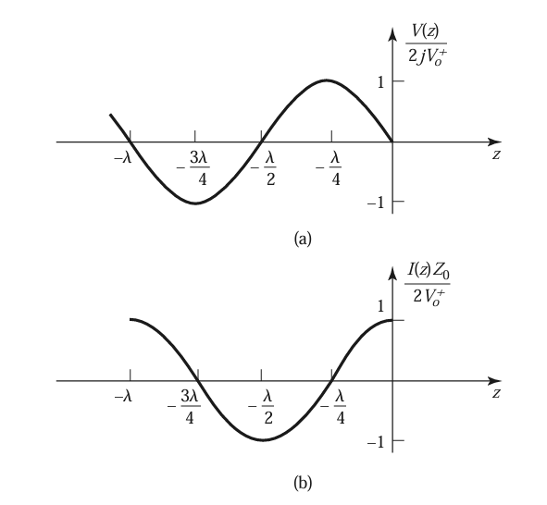
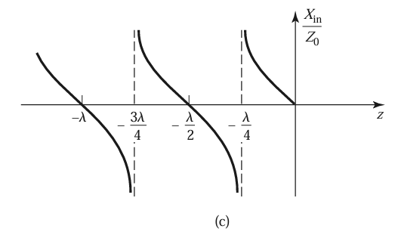
SHORT CIRCUITED LINE
(a) Voltage, (b) current, and (c) impedance (Rin = 0or∞) variation along a short-circuited transmission line.

Slide 5

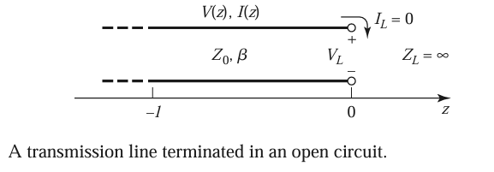
OPEN CIRCUITED LINE
Consider the open-circuited line where ZL =∞
Dividing the numerator and denominator of the above equation by ZL and allowing ZL →∞shows that the reflection coefficient for this case is Г= 1, and the standing wave ratio is again infinite.

Slide 6
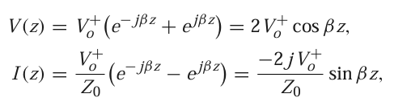

OPEN CIRCUITED LINE
The voltage and current on the line are
which shows that now I = 0 at the load, as expected for an open circuit, while the voltage is maximum. The input impedance is
which is also purely imaginary for any length, l.

Slide 7
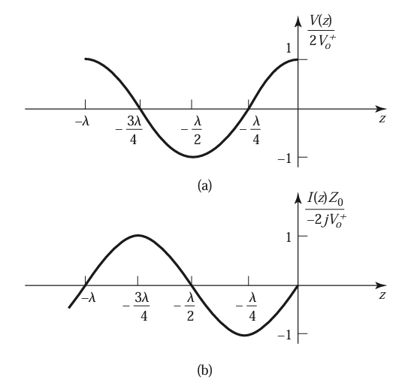
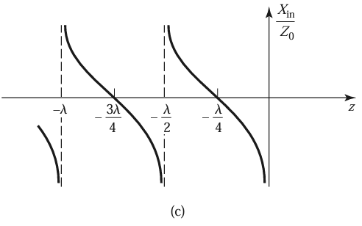
OPEN CIRCUITED LINE
(a) Voltage, (b) current, and (c) impedance (Rin = 0or∞) variation along an open-circuited transmission line.

Slide 8

HALF WAVELENGTH LINE
Consider terminated transmission lines of some special lengths.
If = λ/2,
A half-wavelength line (or any multiple of λ/2) does not alter or transform the load impedance, regardless of its characteristic impedance.

Slide 9

QUARTER-WAVELENGTH
If the line is a quarter-wavelength long or, more generally, l = λ/4 + nλ/2, for n = 1, 2, 3,..., shows that the input impedance is given by
Such a line is known as a quarter-wave transformer because it has the effect of transforming the load impedance in an inverse manner, depending on the characteristic impedance of the line.

